Slide 1
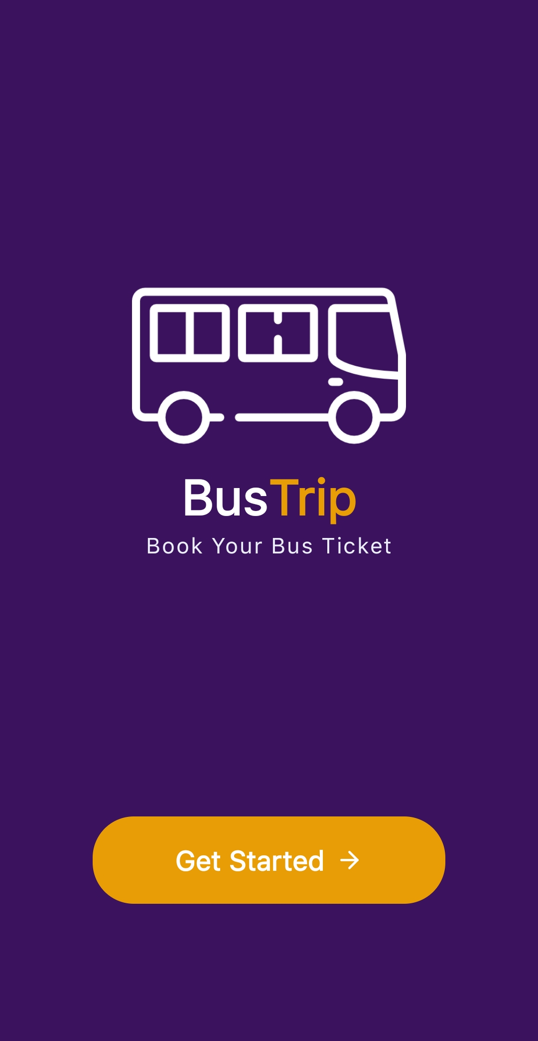
Ticket Booking App
Book your Bus Tickets Anytime, Anywhere in Bangladesh
Team: ZeroGravity
Masud Rana Roll: 2211176104
Nazmul Hasan Roll: 2110476114
Tushar Talukder Roll: 2211076131

Slide 2

Why Ticket Booking App?
Search, Book, and Manage Tickets
Real-time Seat Availability
Secure Digital Payments
See exactly which seats are available instantly
Safe and reliable payment processing
All your ticketing needs in one convenient place

Slide 3
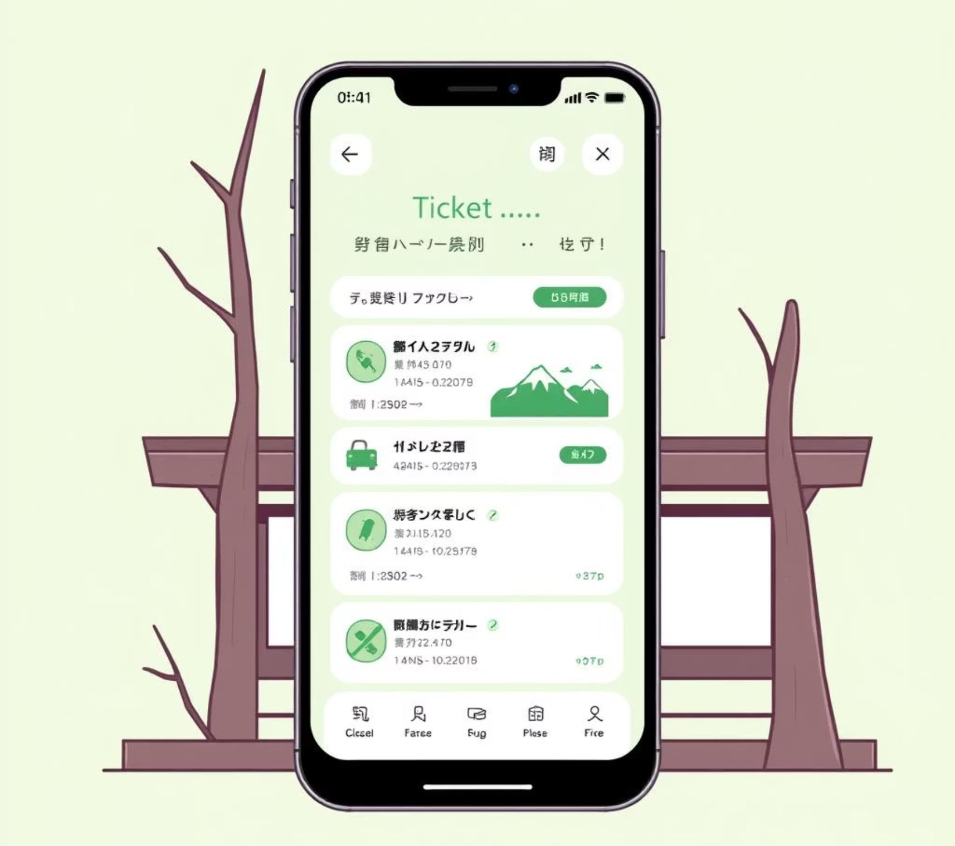
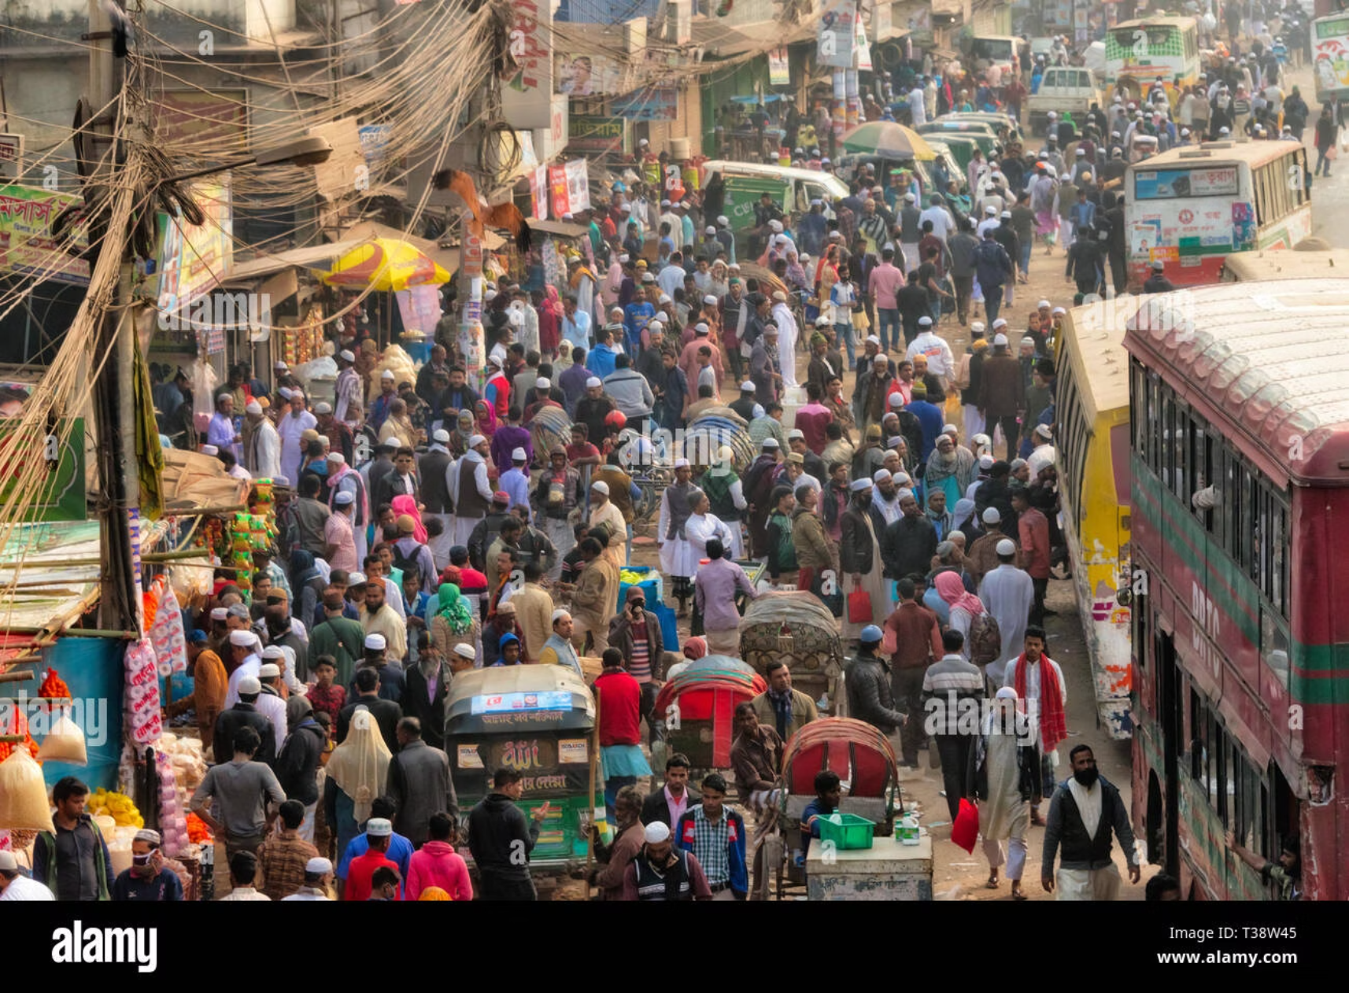
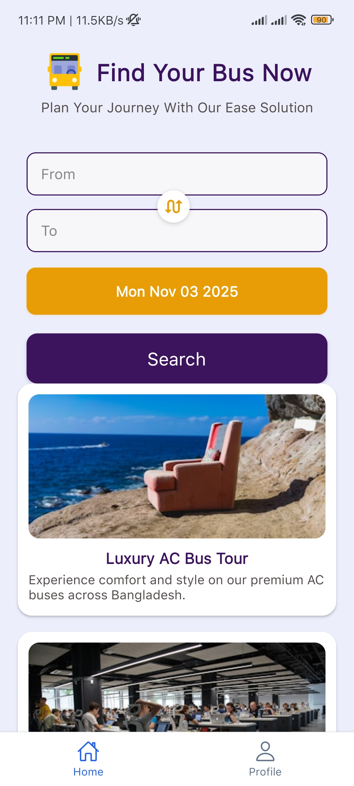
The Problem in Bangladesh
How We Solve It
Manual ticketing is slow & crowded
Easy access to routes and booking in one app
Lack of transparency
Secure login
Hard for rural & urban passengers
Fast booking with date & route selection

Slide 4
Key Features
Search Buses
Real-time Seat Selection
QR Code E-Ticket
Find all available transportation options
Choose your preferred seats instantly
Digital ticket for easy boarding
Booking History
Notifications for Delays
Track all your past reservations
Stay informed about any schedule changes

Slide 5
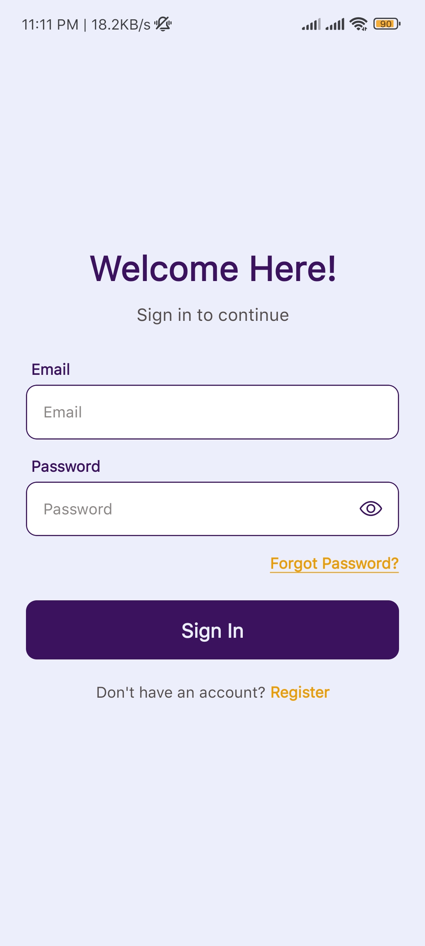
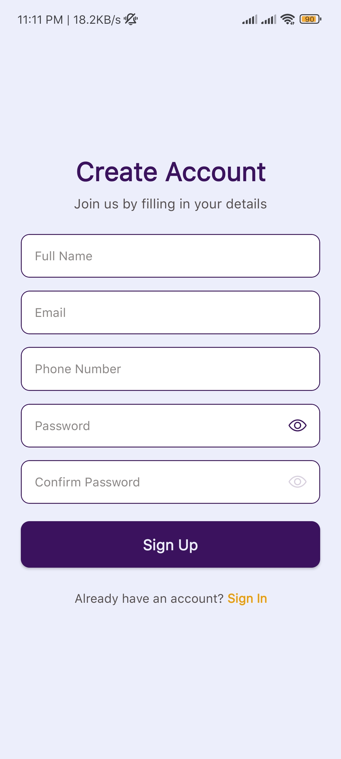
Quick Account Creation
Email, password, easy setup
Fast & Secure Login
Quick login & signup

Slide 6
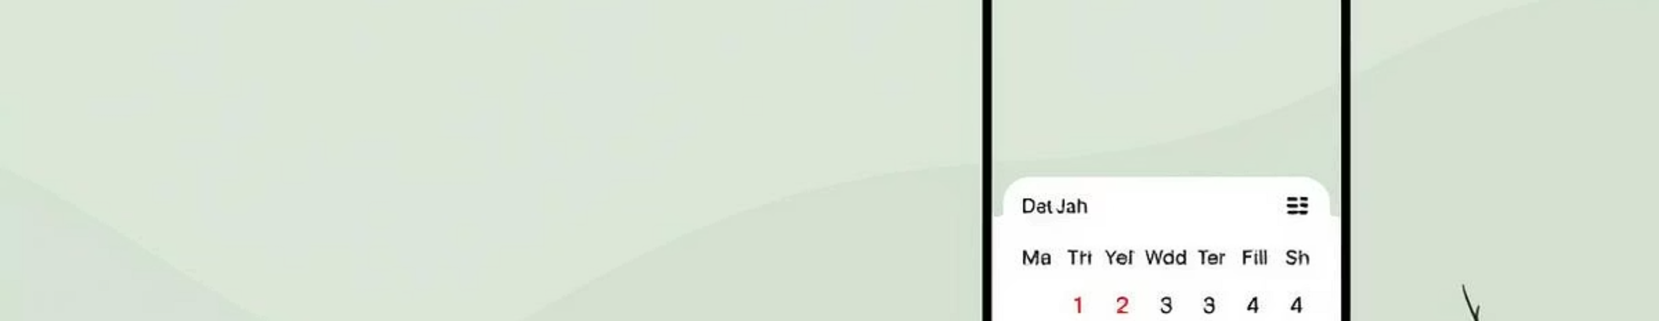
Choose Your Journey
Select Departure
Select Destination
Select Travel Date
Swap Between Departure and Destination

Slide 7
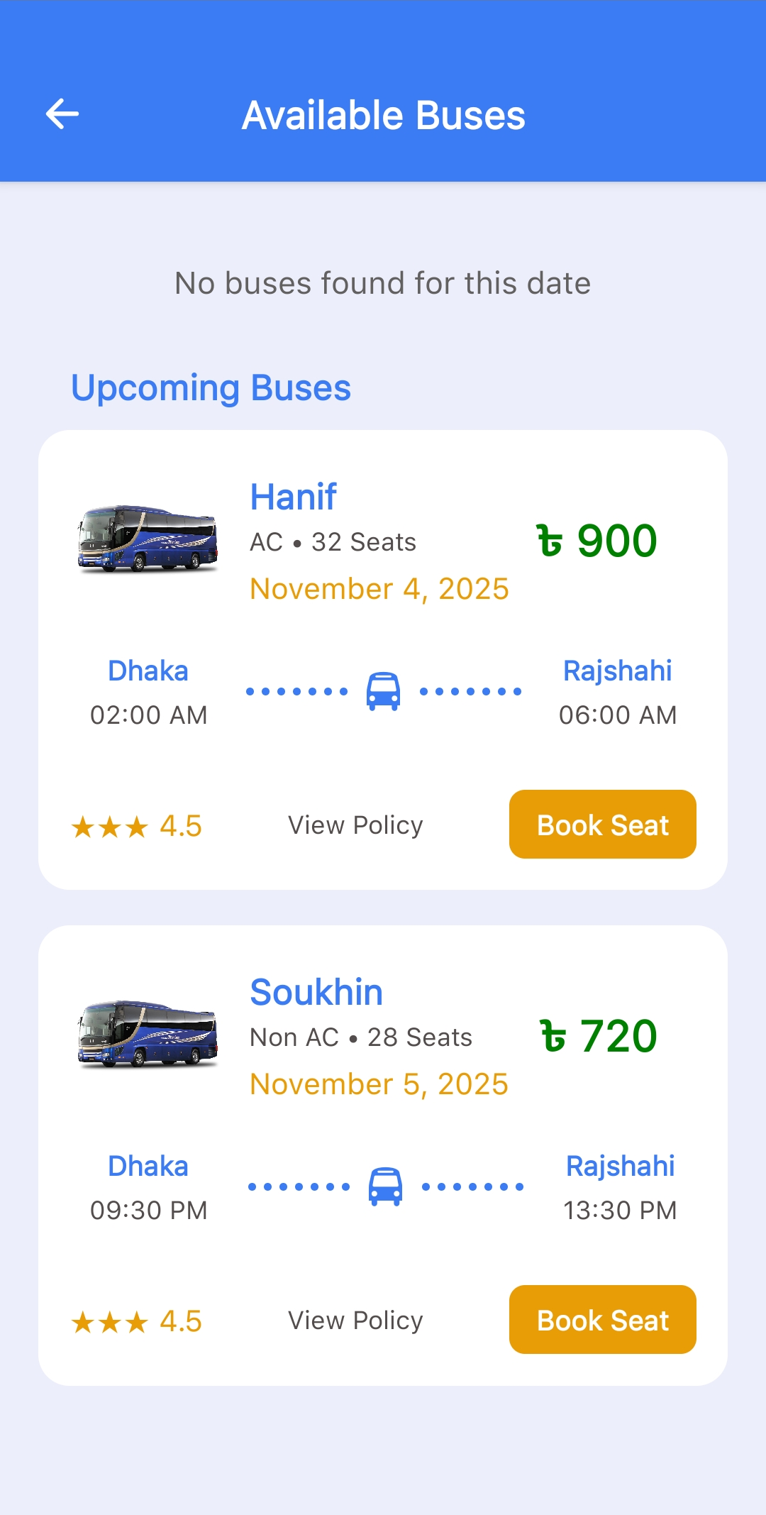
View Available Buses
Show Available All Buses
Show Available Upcoming Buses
Show Bus type, Fare, Date, Time
Seats Availability

Slide 8
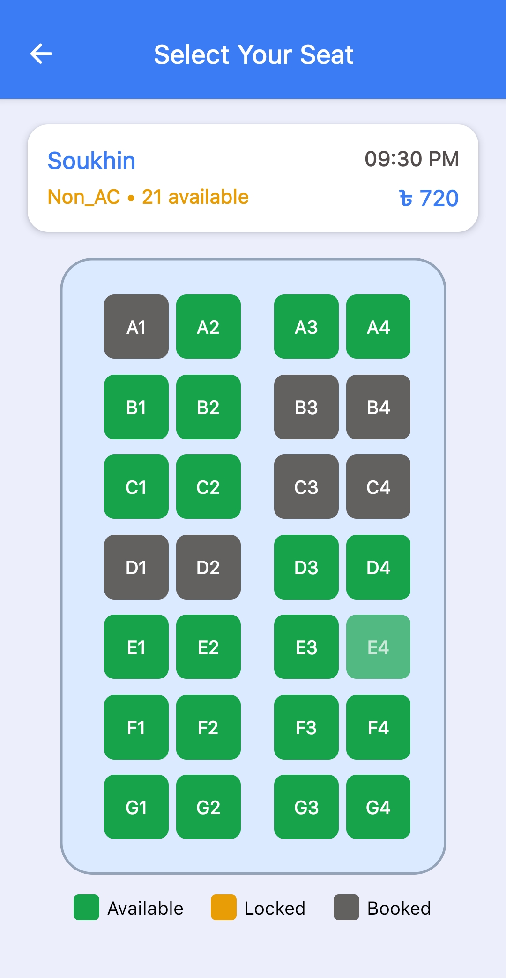
Select Your Seats
Pick preferred seats
color-coded availability
Real time seat selection
Lock seat functionality

Slide 9
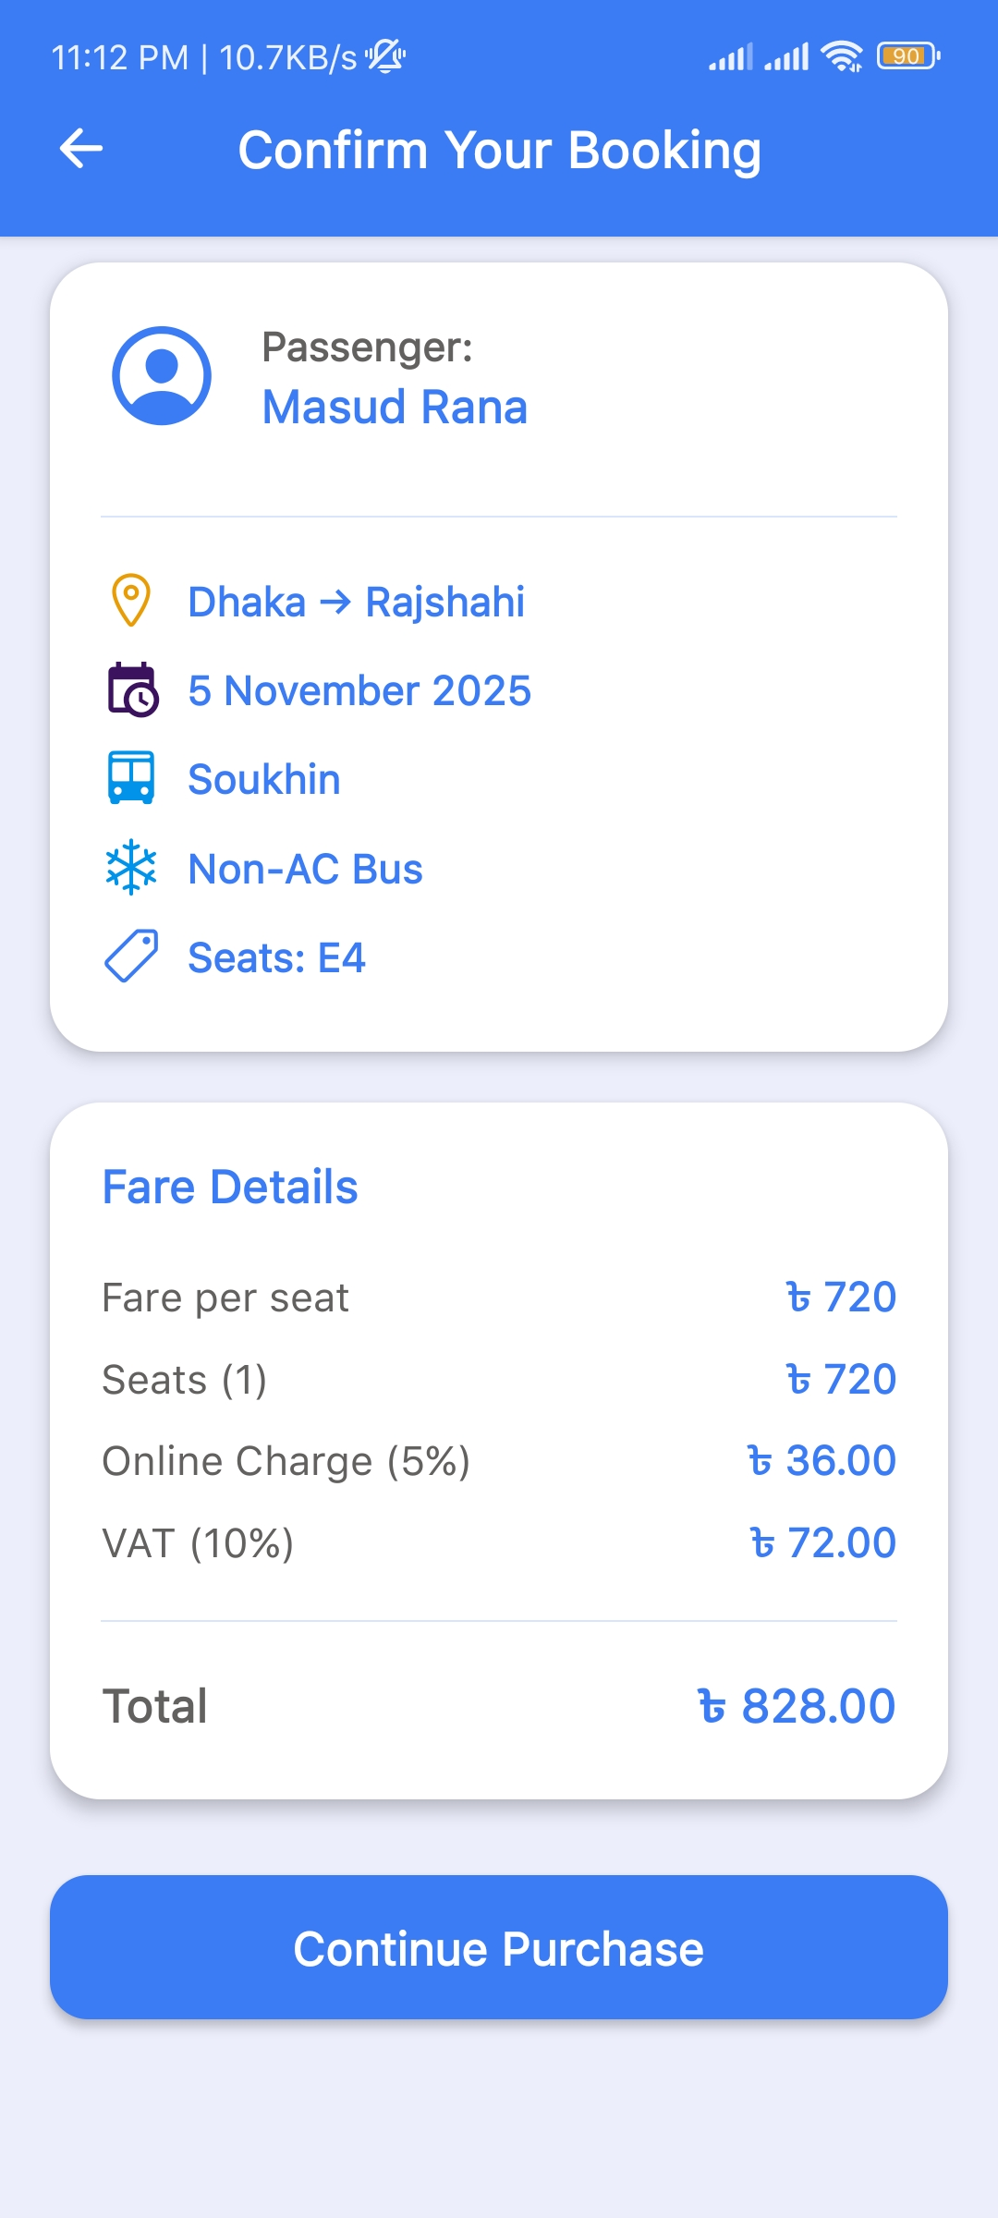
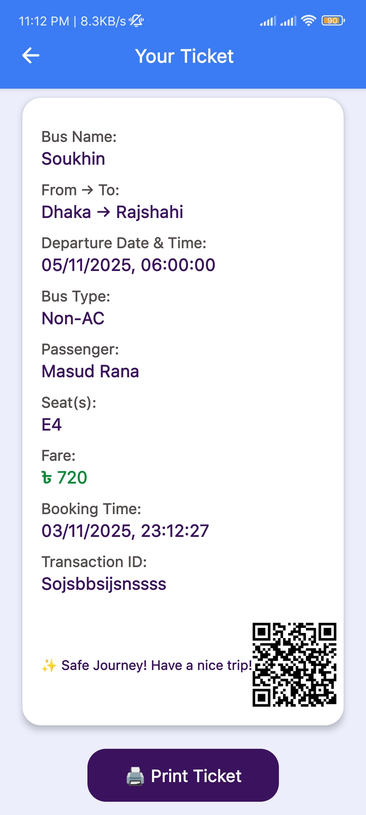
Confirm & Download Ticket
Journey Details
Complete trip information
Seat Numbers
Your reserved seats
Fare
Total ticket price
QR Code
Digital ticket verification

Slide 10
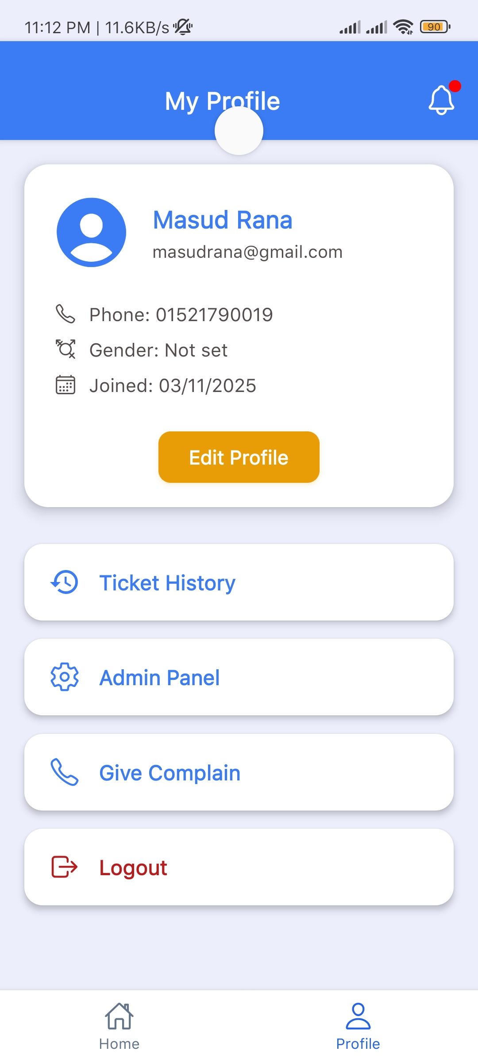
Manage Your Account
View past bookings
Edit profile details
Give Complain
Logout

Slide 11
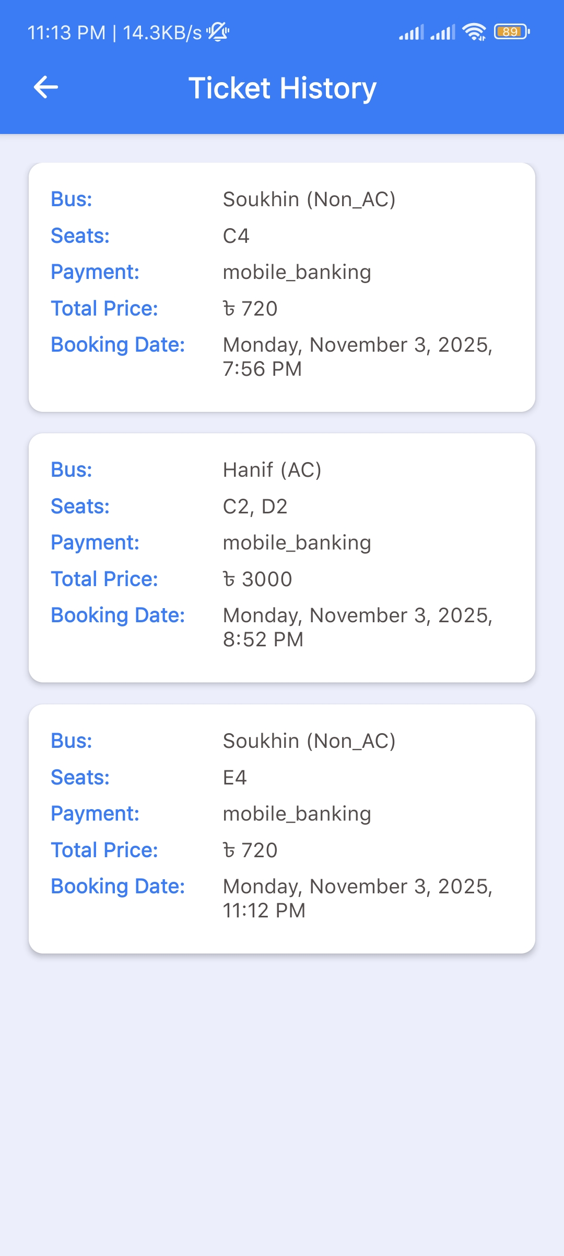
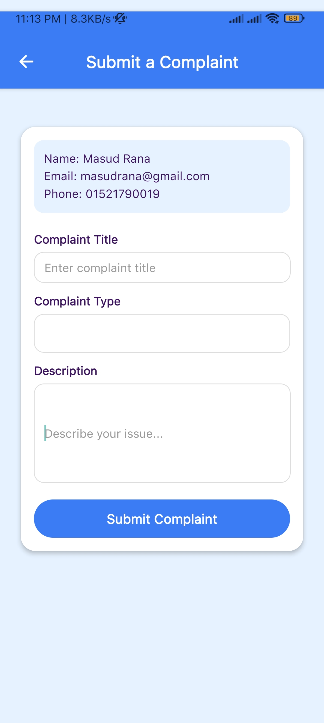
Ticket History
and Complaint
Show all tickets
Submit all types of complains

Slide 12
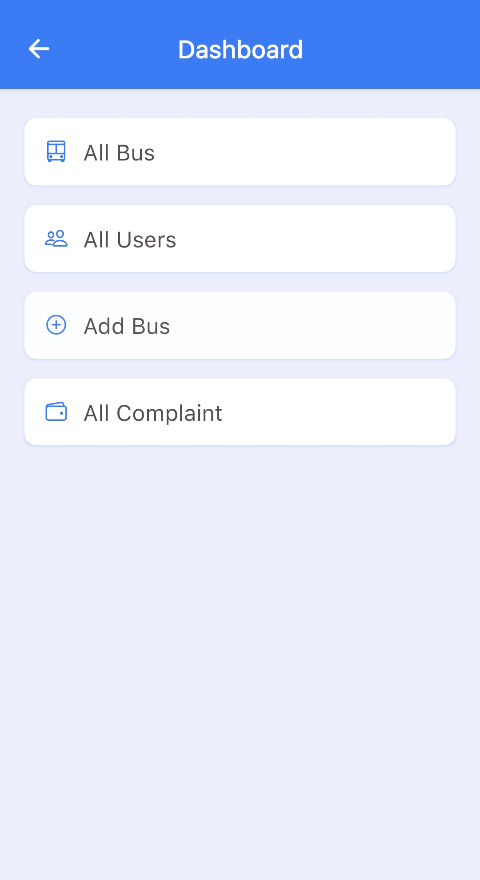
Admin Control
Admin Control
Add buses
Show all Buses
Show All Users
Verify payments
Handle complaints

Slide 13
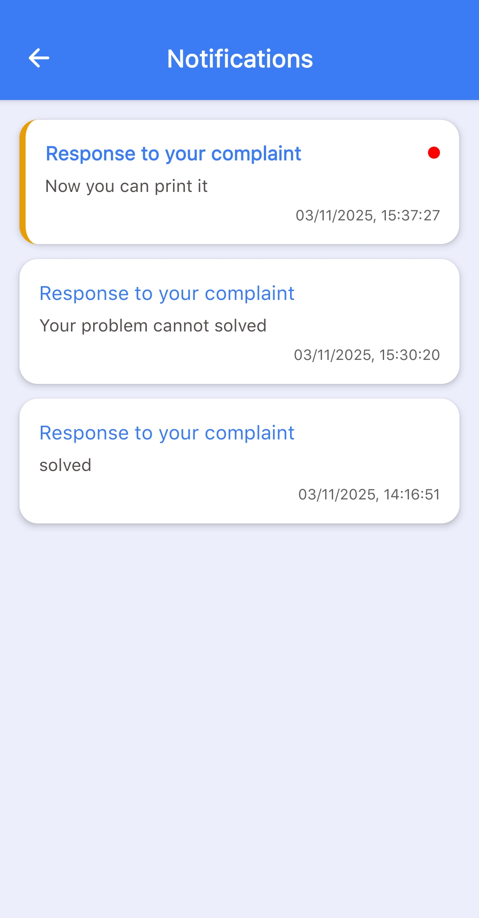
Notifications and Feedback
All feedback Notification
Payment Verification Feedback
Schedule Delay Feedback
Any Complain Solve Feedback

Slide 14
Meet Our Team
Masud Rana
Integration and Backend
Nazmul Hasan
Authentication and Profile
Tushar Talukder
UI Design and Presentation

Slide 15
Thank You

